Slide 1


DARE TO DREAM
The Imara Sickle Cell Framework
Primary Interventions
Leveraging Community Engagement
Secondary Interventions
Routine Care Provision
Tertiary Interventions
Specialized and Complex Care
Focus on community engagement, early disease identification and early linkage to care.
Focus on strengthening existing healthcare capacity to provide routine care while ensuring availability of diagnostic, medicine and blood with local trained healthcare professionals.
Focus on strengthening existing healthcare capacity to provide specialised and complex care leveraging trained healthcare specialists.
Activity 1 | Community awareness
Activity 2 | Newborn, early infant, and cascade screening
Activity 3 | Sustainable linkage to care
Activity 4 | Routine medical management
Activity 5 | Laboratory and imaging diagnostics
Activity 6 | Availability of safe and adequate blood components
Activity 7 | Complication management (acute and chronic care)
Focus on information systems to maximize patient management and public health assessment, healthcare financing and overall programme management.
Activity 8 | SCD data management system
Activity 9 | Healthcare financing
Activity 10 | Programme management
Cross-Cutting Engagements
Monitoring, Access to Care and Driving Adequate Execution

Slide 2



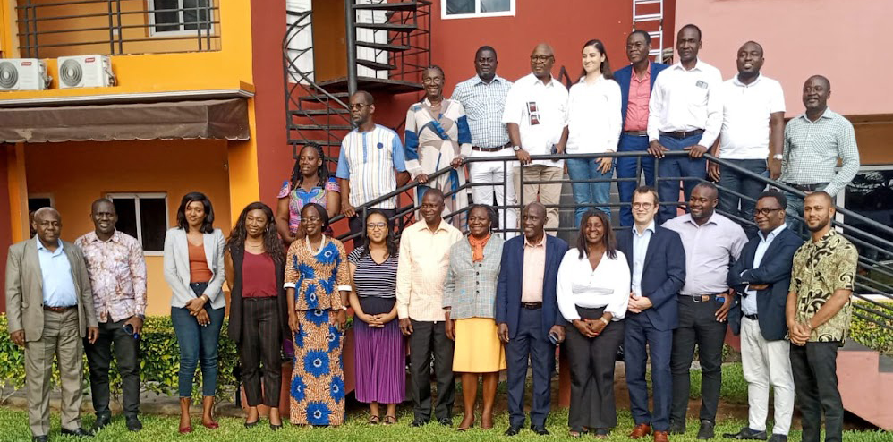
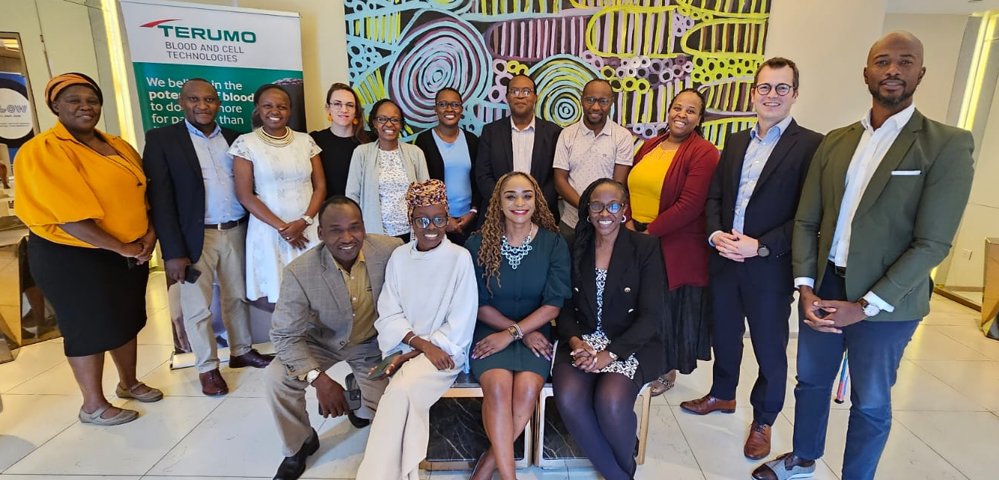
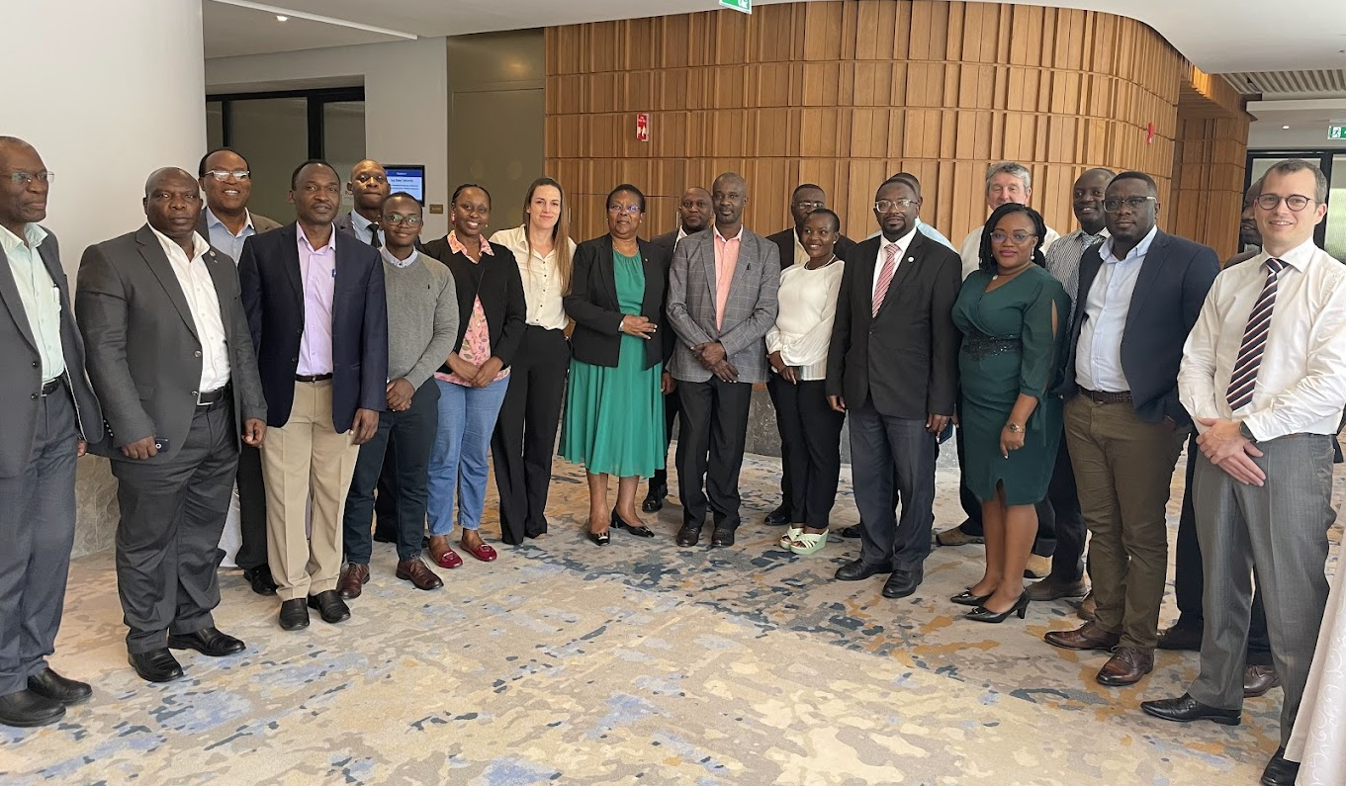
DARE TO DREAM
Coalition of the Willing Engaged towards same Objective
COMMON OBJECTIVE
To design a comprehensive,
multi-dimensional and integrated framework
for the management of SCD
39 experts across 3 African Countries + WCSCD

Slide 3
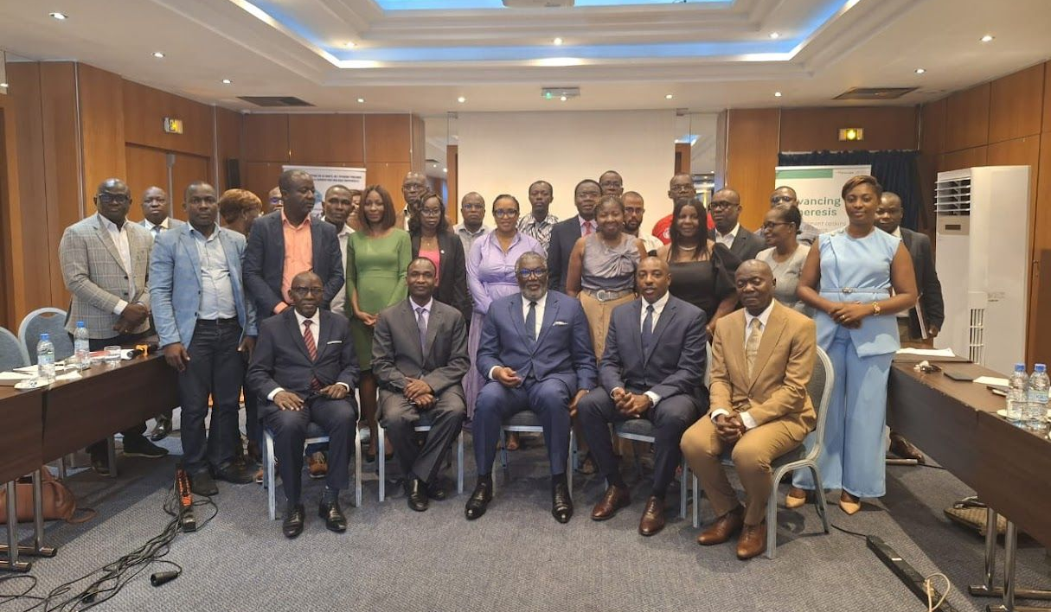

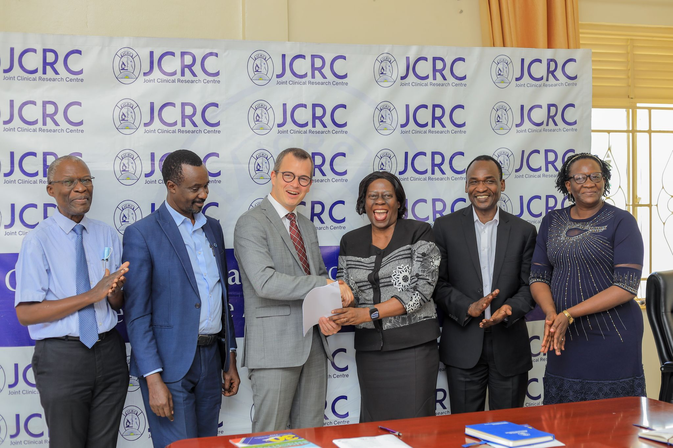
DARE TO DREAM
Three Pioneering Countries to Implement Imara Vertically
Three MoUs signed: Formalizing government commitment, defining roles and responsibilities, and establishing a foundation for effective collaboration, scalability, and long-term sustainability.
MOU Signings

Slide 4
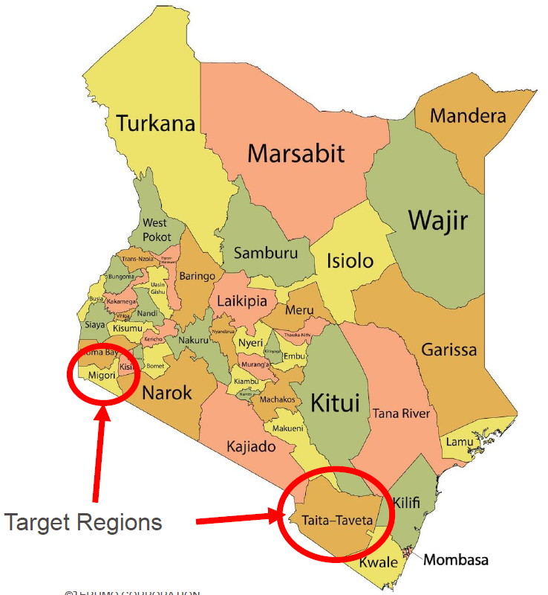
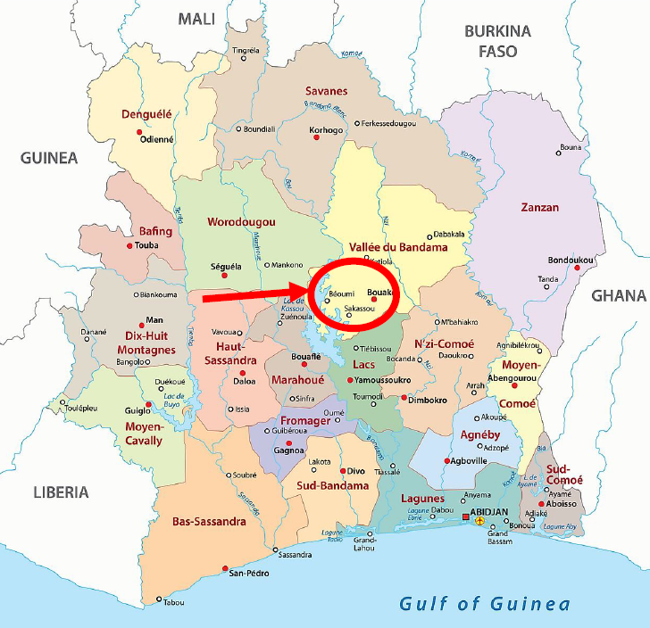
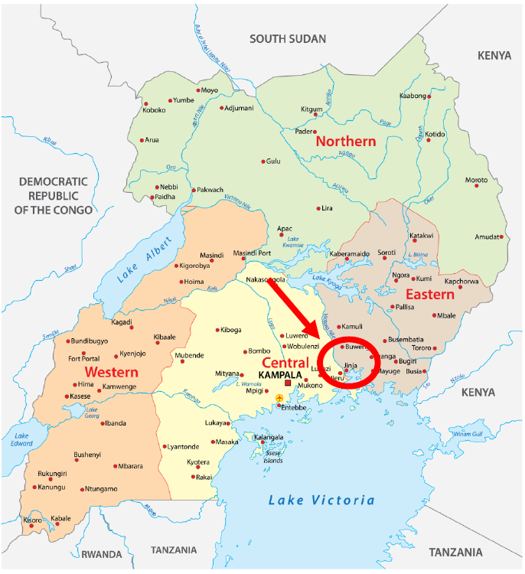
DARE TO DREAM
Four Geographies Selected
Côte d’Ivoire, Gbêkê
Kenya, Migori
Kenya, Taita Taveta
Uganda, Jinja
4.9% of Country Population
1.2% of Country Population
0.7% of Country Population
1.3% of Country Population

Slide 5
DARE TO DREAM
Conclusions
1. A validated roadmap
39 experts, multi-country alignment
One integrated framework across all levels of care
2. Coordination Drive Impact
From fragmented initiatives → coordinated continuum of care
Built on existing health systems and MoH leadership
3. Now is the Time to Scale
Countries committed (MoUs signed)
Implementation geographies identified
PPPs unlock sustainable financing in declining ODA context
→ Strong agreement on relevance and feasibility
→ Impact comes from connection, not isolated interventions
→ Everything is in place to move from pilots to national scale
The question is no longer “what to do” — but “how fast can we scale it?”

